Slide 1
Classical NLP
Jason Eisner
JSALT Summer School
June 2026

Slide 2
How did we get here?
350 BCE: Panini: Grammatical analysis of natural language
1936: Post, Turing: Formal languages
1948: Shannon: “A Mathematical Theory of Communication” (information theory, language modeling)
1949: Weaver: The machine translation task
1950: Turing Test: The conversational AI task
1957: Chomsky:Syntactic Structures (generative linguistics)
1957: Firth: “You shall know a word by the company it keeps” (corpus linguistics)
1957: Rosenblatt: perceptrons (neural nets)
1962: Association for Computational Linguistics

Slide 3
How did we get here?
1970s: Jelinek et al.: Statistical speech-to-text
1986: PDP books: Rebirth of neural nets (in cognitive science)
1988: Statistical part of speech tagging
1990s: Probabilistic NLP (for 30 years)
2000s: Early neural language modeling
2010s: Word representation learning & neural task models in NLP
2018: Contextual word representation learning (ELMo & BERT)
2019: Generative LMs (GPT-2)
2020: Few-shot NLP via LMs (GPT-3)
2022: Conversational, instruction-following LMs (ChatGPT)

Slide 4
Where are we now?
Skip the NLP course?
  Just become an LLM whisperer … art of workflows …
Maybe, but it might be useful to know:
  What are the phenomena of natural language?
  How were they described in linguistics and turned into engineering tasks by (probabilistic) NLP?
  How could you build fast, cheap, targeted models to solve those tasks? (LLMs aren’t always the right tool)
  What are big reusable ideas from linguistics/NLP/ML?
Unsolved: How do kids learn language (low data)?

Slide 5
Ambiguity: Favorite Headlines
Iraqi Head Seeks Arms
Is There a Ring of Debris Around Uranus?
Juvenile Court to Try Shooting Defendant
Teacher Strikes Idle Kids
Stolen Painting Found by Tree
Kids Make Nutritious Snacks
Local HS Dropouts Cut in Half
Obesity Study Looks for Larger Test Group

Slide 6
Ambiguity: Favorite Headlines
British Left Waffles on Falkland Islands
Never Withhold Herpes Infection from Loved One
Red Tape Holds Up New Bridges
Man Struck by Lightning Faces Battery Charge
Clinton Wins on Budget, but More Lies Ahead
Hospitals Are Sued by 7 Foot Doctors

Slide 7
Levels of Language
Phonetics/phonology/morphology: what words (or subwords) are we dealing with?
Syntax: What phrases are we dealing with? Which words modify one another?
Semantics: What’s the literal meaning?
Pragmatics: What should you conclude from the fact that I said something? How should you react?

Slide 8
Task-centric view of the world
Task
x
y
evaluation
(loss function)
e.g., p(y|x) model
and decoder

Slide 9

Translate linguistic form ↔ meaning
Or form ↔ alternate form
Map input to output:
  speech → text
  text → speech
  Arabic → English
  unedited → edited
  document → summary
  sentence → meaning
  document → database record
  query → relevant documents
  question → answer
  email → is it spam?
Dream up a model of p(output | input)
Fit the model’s parameters from whatever data you can get
Invent an algorithm to maximize
p(output | input) on new inputs
?
Notes:
Linguistic forms are spoken or written words, sentences, or documents. Maybe tweets with lots of misspellings and slang. We might want to convert from one linguistic form to another, like going back and forth between speech and text, or two languages. Or we might want to extract meaning from the documents and use that to answer questions and talk back to the user.

Slide 10
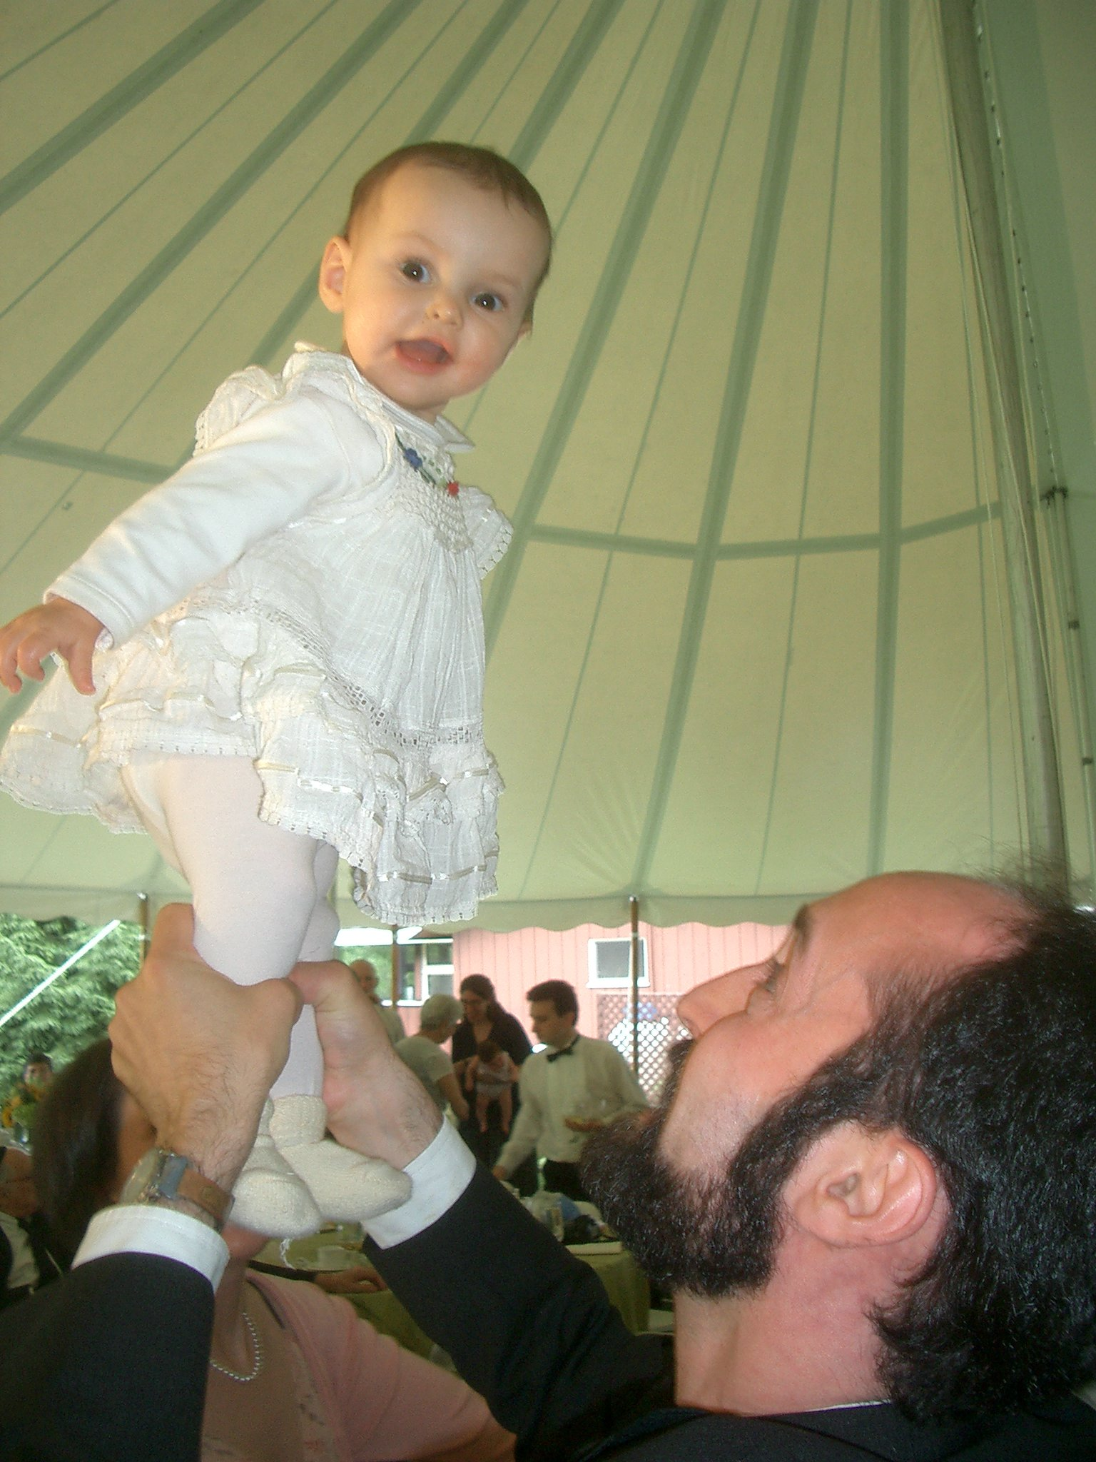

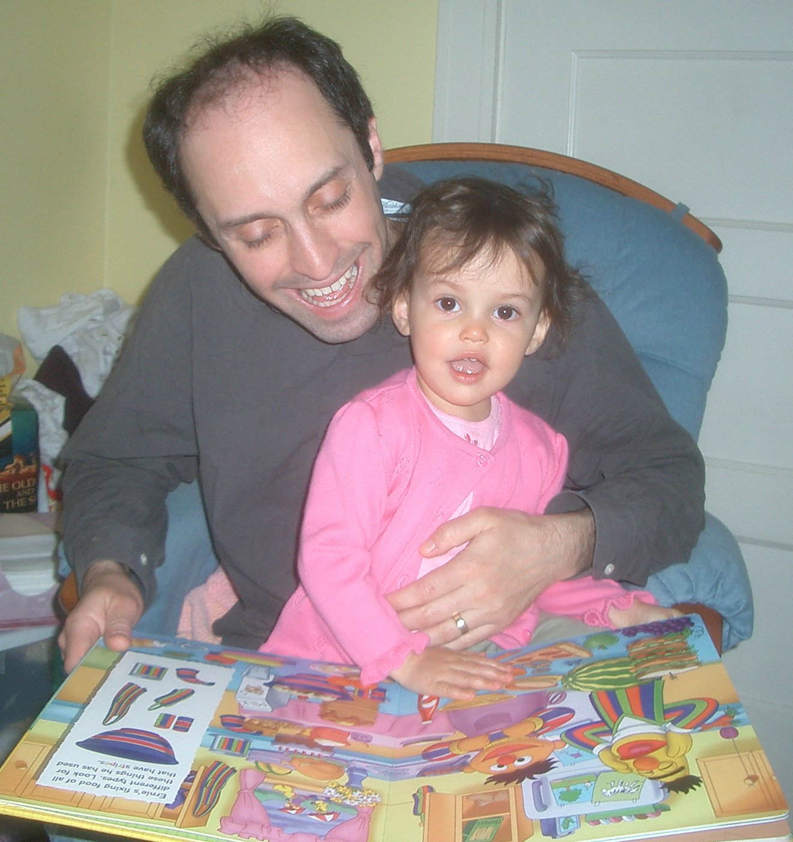
Automatically Discovering Structure
?
One of the two best language-
learning devices I helped build
(this is model 1, from 2003)
t
s
a
t
s
2005 (fairly fluent)
2004 (pre-babbling)
Notes:
I’ll close with an advertisement for unsupervised learning.
We’d like to build systems that automatically figure out the structure of a language, without being explicitly taught. I’ve built several such systems, but two of them are just much better than the rest. This one went from grunting to fluent English in less than a year. So that’s a grand challenge for you: catch up with the toddlers. Their brains are completely amazing devices for working out what’s going on in language, and we want to do more of that.

Slide 11
Task-centric view of the world
Task
x
y
p(y|x) model
loss function
Great way to track progress & compare systems
  But may fracture us into subcommunities
  (our systems are incomparable & my semantics != your semantics)
Room for all of AI when solving any NLP task
  Spelling correction could get some benefit from deep semantics, unsupervised grammar induction, active learning, discourse, etc.
  But in practice, focus on raising a single performance number
  Within strict, fixed assumptions about the type of available data
Do we want to build models & algs that are good for just one task?
Notes:
Spelling correction: Humans do all kinds of reasoning about what was really meant in this context; they can even whether the misspelling was deliberate (pun, persona, implicit quotation, other metalinguistic behavior). But as an engineering matter, this doesn’t help much?
Do we want to build models & algs that are good for just one task? There are some tasks that are genuinely worth solving as formulated, at least for now. Others are set up as academic exercises to motivate research, and there they may motivate peculiar research directions (e.g., RTE using n-grams). Either way, when the task parameters change, a lot of effort falls on the floor. Of course it keeps us busy always building the next system; but we may be missing opportunities for fundamental progress and reuse. Surely humans do tune to particular tasks, for both speed and accuracy, and I’ll say more about that at the end. But that is perhaps on top of an architecture that also lets them puzzle out the answers new tasks without training from scratch.

Slide 12
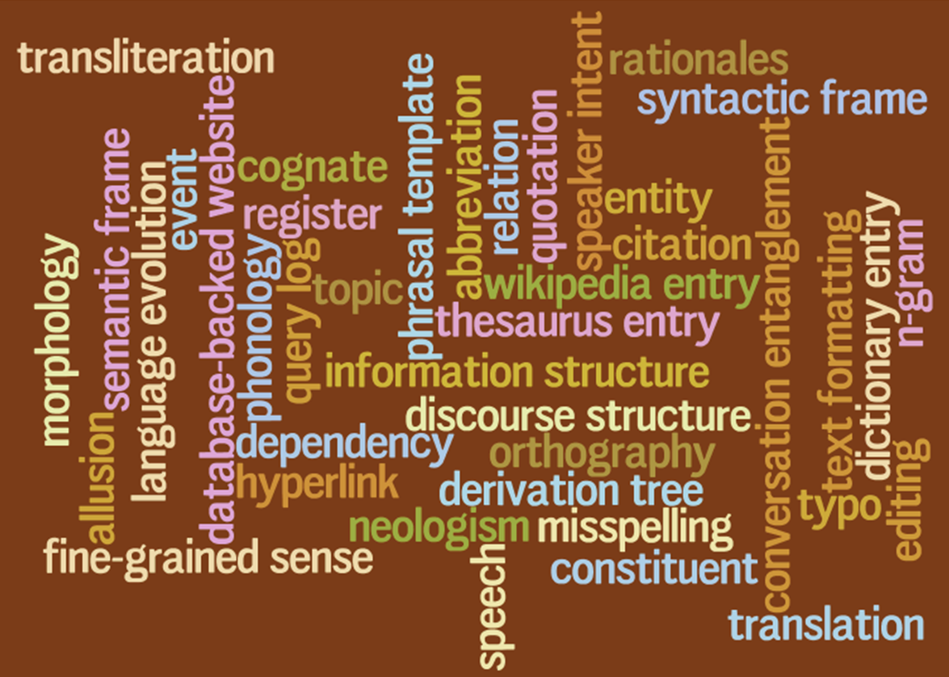
Variable-centric view of the world
When we deeply understand language, what representations
(type and token) does that understanding comprise?
Notes:
Focus on what variables might help us understand and produce language.
Some are token variables (utterance-specific), others are type variables (language-specific).
Might be observed or latent.
How those variables are represented, what the priors are, and (next slide) how they interrelate.

Slide 13
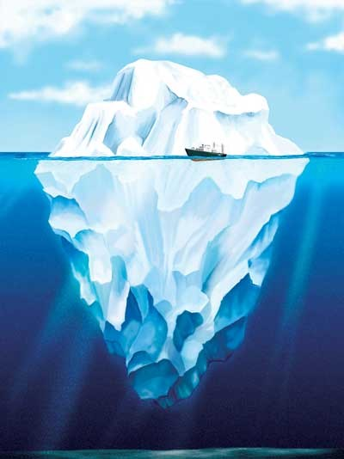

Bayesian View of the World
observed data
probability
distribution
hidden data

Slide 14
Different tasks merely change which variables are observed and which ones you care about inferring
 | comprehension | production | learning
sentence | ✓ | ? | ✓
syntax tree | (?) | latent | (✓)
semantics | (?) | (✓) | (✓)
facts about speaker/world | (?) | (✓) | (✓)
facts about the language | ✓ | ✓ | ?

Slide 15
Different tasks merely change which variables are observed and which ones you care about inferring
 | comprehension | production | learning
surface form of word | ✓ | ? | ✓
surface ⬄ underlying alignment | (?) | latent | (✓)
underlying form of word | (?) | latent | (✓)
abstract morphemes in word | (?) | ✓ | (✓)
underlying form of morphemes (lexicon) | ✓ | ✓ | (?)
constraint ranking (grammar) | ✓ | ✓ | (?)

Slide 16
Different tasks merely change which variables are observed and which ones you care about inferring
 | MT decoding | MT training | cross-lingual projection
Chinese sentence | ✓ | ✓ | ✓
Chinese parse | latent | latent | ?
English parse | latent | latent | ✓
English sentence | ? | ✓ | ✓
translation & language models | ✓ | ? | ?

Slide 17
All you need is “p”
Science = a descriptive theory of the world
Write down a formula for
p(everything)
everything = observed ∪ needed ∪ latent
Given observed, what might needed be?
Most probable settings of needed are those that give comparatively large values of
∑_{latent} p(observed, needed, latent)
Formally, we want p(needed | observed)
= p(observed, needed) / p(observed)
  Since observed is constant, the conditional probability of needed varies with p(observed, needed), which is given above
(What do we do then?)

Slide 18
All you need is “p”
Science = a descriptive theory of the world
Write down a formula for
p(everything)
everything = observed ∪ needed ∪ latent
p can be any non-negative function you care to design
  (as long as it sums to 1)
  (or another finite positive number: just rescale)
But it’s often convenient to use a graphical model
  Flexible modeling technique
  Well understood
  We know how to (approximately) compute with them

Slide 19
Graphical model notation
slide thanks to Zoubin Ghahramani

Slide 20
Factor graphs
slide thanks to Zoubin Ghahramani

Slide 21
Rather basic NLP example
First, a familiar example
  Conditional Random Field (CRF) for POS tagging
Possible tagging (i.e., assignment to remaining variables)
…
…
v
v
v
find
preferred
tags
Observed input sentence (shaded)
21
Notes:
21

Slide 22
Rather basic NLP example
First, a familiar example
  Conditional Random Field (CRF) for POS tagging
Possible tagging (i.e., assignment to remaining variables)
Another possible tagging
…
…
v
a
n
find
preferred
tags
Observed input sentence (shaded)
22
Notes:
22

Slide 23
Conditional Random Field (CRF)
”Binary” factor that measures compatibility of 2 adjacent tags
 | v | n | a
v | 0 | 2 | 1
n | 2 | 1 | 0
a | 0 | 3 | 1
 | v | n | a
v | 0 | 2 | 1
n | 2 | 1 | 0
a | 0 | 3 | 1
Model reuses
same parameters
at this position
…
…
find
preferred
tags
23
Notes:
23

Slide 24
Conditional Random Field (CRF)
 | v | n | a
v | 0 | 2 | 1
n | 2 | 1 | 0
a | 0 | 3 | 1
 | v | n | a
v | 0 | 2 | 1
n | 2 | 1 | 0
a | 0 | 3 | 1
…
…
v | 0.3
n | 0.02
a | 0
v | 0.3
n | 0
a | 0.1
v | 0.2
n | 0.2
a | 0
find
preferred
tags
can’t be adj
24
Notes:
24

Slide 25
Conditional Random Field (CRF)
p(v a n) is proportional
to the product of all
factors’ values on v a n
 | v | n | a
v | 0 | 2 | 1
n | 2 | 1 | 0
a | 0 | 3 | 1
 | v | n | a
v | 0 | 2 | 1
n | 2 | 1 | 0
a | 0 | 3 | 1
…
…
v
a
n
v | 0.3
n | 0.02
a | 0
v | 0.3
n | 0
a | 0.1
v | 0.2
n | 0.2
a | 0
find
preferred
tags
25
Notes:
25

Slide 26
Conditional Random Field (CRF)
p(v a n) is proportional
to the product of all
factors’ values on v a n
 | v | n | a
v | 0 | 2 | 1
n | 2 | 1 | 0
a | 0 | 3 | 1
 | v | n | a
v | 0 | 2 | 1
n | 2 | 1 | 0
a | 0 | 3 | 1
= … 1*3*0.3*0.1*0.2 …
…
…
v
a
n
v | 0.3
n | 0.02
a | 0
v | 0.3
n | 0
a | 0.1
v | 0.2
n | 0.2
a | 0
find
preferred
tags
MRF vs. CRF?
26
Notes:
26

Slide 27
Inference: What do you know how to compute with this model?
p(v a n) is proportional
to the product of all
factors’ values on v a n
 | v | n | a
v | 0 | 2 | 1
n | 2 | 1 | 0
a | 0 | 3 | 1
 | v | n | a
v | 0 | 2 | 1
n | 2 | 1 | 0
a | 0 | 3 | 1
= … 1*3*0.3*0.1*0.2 …
…
…
v
a
n
v | 0.3
n | 0.02
a | 0
v | 0.3
n | 0
a | 0.1
v | 0.2
n | 0.2
a | 0
find
preferred
tags
Maximize, sample, sum …
27
Notes:
27

Slide 28
Variable-centric view of the world
When we deeply understand language, what representations
(type and token) does that understanding comprise?
Notes:
Focus on what variables might help us understand and produce language.
Some are token variables (utterance-specific), others are type variables (language-specific).
Might be observed or latent.
How those variables are represented, what the priors are, and (next slide) how they interrelate.

Slide 29
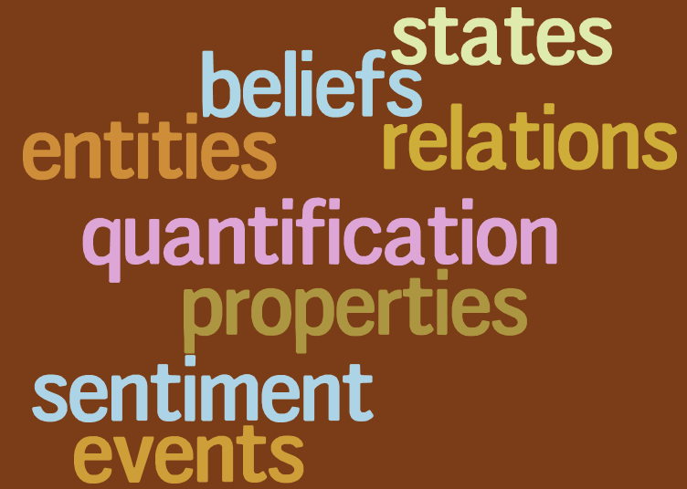
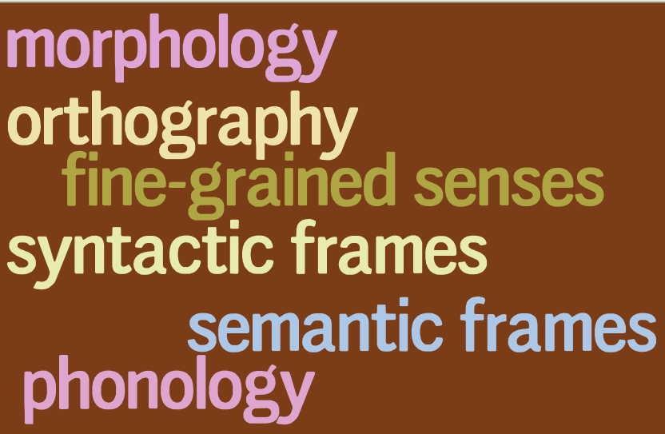
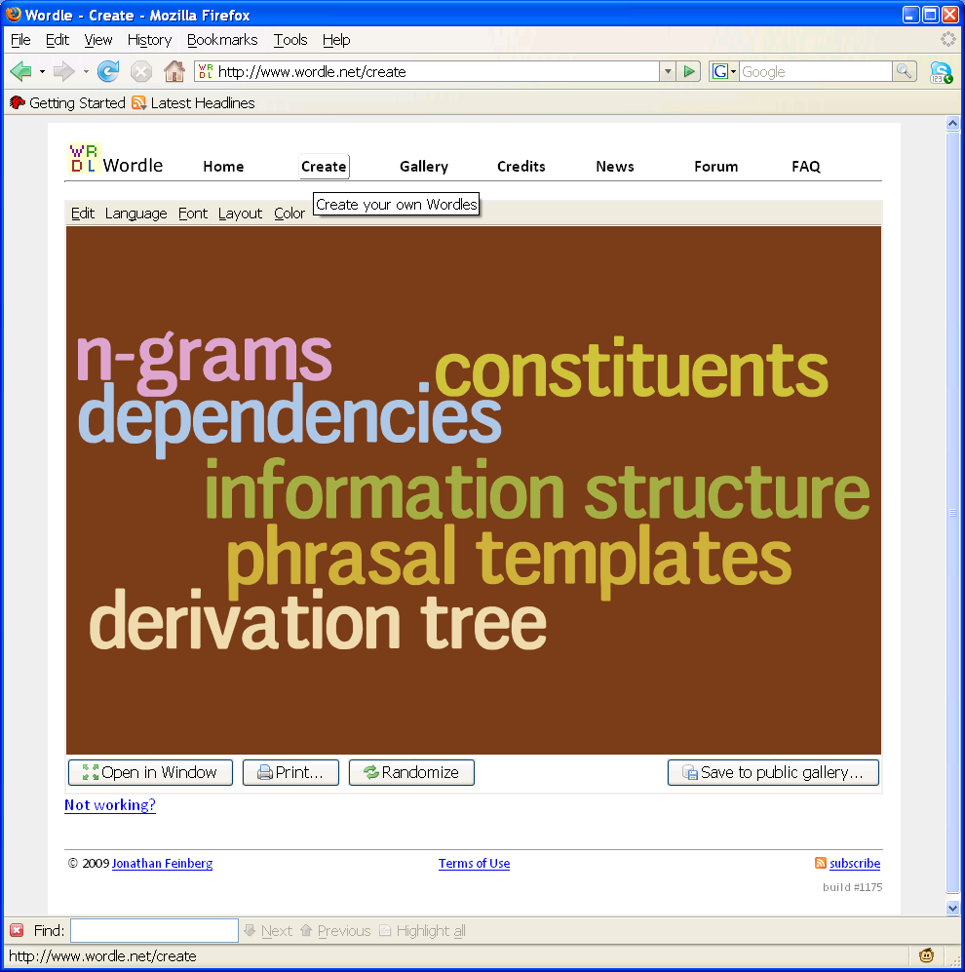
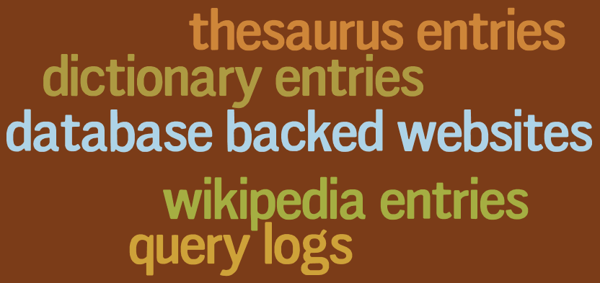
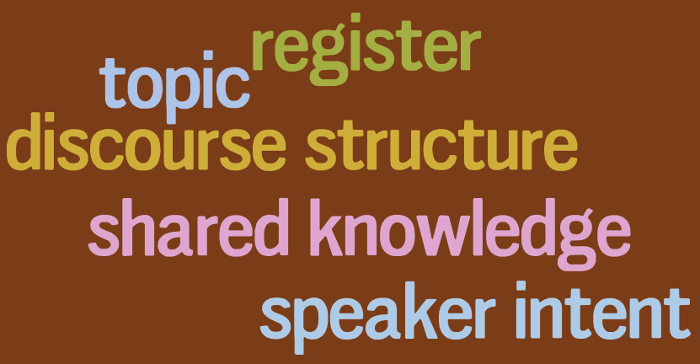
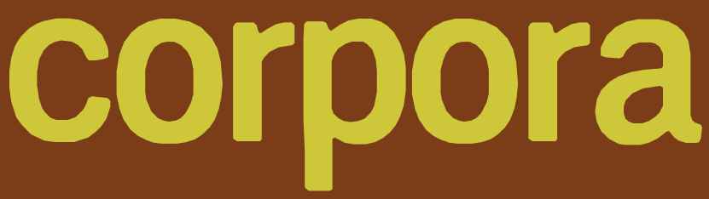
semantics
lexicon (word types)
inflection
cognates
transliteration
abbreviation
neologism
language evolution
entailment
correlation
tokens
sentences
N
translation
alignment
editing
quotation
resources
speech
misspellings,typos
formatting
entanglement
annotation
discourse context
To recover variables,
model and exploit
their correlations
Notes:
I don’t want to learn to do tasks but rather learn to understand what’s going on in the language I see;
happy to take help from direct or indirect supervision or other resources

Slide 30
How do you design the factors?
It’s easy to connect “English sentence” to “Portuguese sentence” …
  … but you have to design a specific function that measures how compatible a pair of sentences is.
Often, you can think of a generative story in which the individual factors are themselves probabilities.
  May require some latent variables.

Slide 31
Directed graphical models (Bayes nets)
Under any model: p(A, B, C, D, E) = p(A)p(B|A)p(C|A,B)p(D|A,B,C)p(E|A,B,C,D)
Model above says:
slide thanks to Zoubin Ghahramani (modified)

Slide 32
Language ID
“Horses and Lukasiewicz are on the curriculum.”
Is this English or Polish or what?
We had some notion of using n-gram models …
Is it “good” (= likely) English?
Is it “good” (= likely) Polish?
Space of outcomes will be not races but character sequences (x₁, x₂, x₃, …) where x_{n} = EOS

Slide 33
Language ID
Let p(X) = probability of text X in English
Let q(X) = probability of text X in Polish
Which probability is higher?
  (we’d also like bias toward English since it’s more likely a priori – ignore that for now)
“Horses and Lukasiewicz are on the curriculum.”
p(x₁=h, x₂=o, x₃=r, x₄=s, x₅=e, x₆=s, …)

Slide 34
Apply the Chain Rule
p(x₁=h, x₂=o, x₃=r, x₄=s, x₅=e, x₆=s, …)
= p(x₁=h)
* p(x₂=o | x₁=h)
* p(x₃=r | x₁=h, x₂=o)
* p(x₄=s | x₁=h, x₂=o, x₃=r)
* p(x₅=e | x₁=h, x₂=o, x₃=r, x₄=s)
* p(x₆=s | x₁=h, x₂=o, x₃=r, x₄=s, x₅=e)
* …
4470/ 52108
395/ 4470
5/ 395
3/ 5
3/ 3
0/ 3
counts from Brown corpus
= 0

Slide 35
Back Off On Right Side
p(x₁=h, x₂=o, x₃=r, x₄=s, x₅=e, x₆=s, …)
≈ p(x₁=h)
* p(x₂=o | x₁=h)
* p(x₃=r | x₁=h, x₂=o)
* p(x₄=s | x₂=o, x₃=r)
* p(x₅=e | x₃=r, x₄=s)
* p(x₆=s | x₄=s, x₅=e)
* … = 7.3e-10 * …
4470/ 52108
395/ 4470
5/ 395
12/ 919
12/ 126
3/ 485
counts from Brown corpus

Slide 36
Change the Notation
p(x₁=h, x₂=o, x₃=r, x₄=s, x₅=e, x₆=s, …)
≈ p(x₁=h)
* p(x₂=o | x₁=h)
* p(x_{i}=r | x_{i-2}=h, x_{i-1}=o, i=3)
* p(x_{i}=s | x_{i-2}=o, x_{i-1}=r, i=4)
* p(x_{i}=e | x_{i-2}=r, x_{i-1}=s, i=5)
* p(x_{i}=s | x_{i-2}=s, x_{i-1}=e, i=6)
* … = 7.3e-10 * …
4470/ 52108
395/ 4470
5/ 395
12/ 919
12/ 126
3/ 485
counts from Brown corpus

Slide 37
Another Independence Assumption
p(x₁=h, x₂=o, x₃=r, x₄=s, x₅=e, x₆=s, …)
≈ p(x₁=h)
* p(x₂=o | x₁=h)
* p(x_{i}=r | x_{i-2}=h, x_{i-1}=o)
* p(x_{i}=s | x_{i-2}=o, x_{i-1}=r)
* p(x_{i}=e | x_{i-2}=r, x_{i-1}=s)
* p(x_{i}=s | x_{i-2}=s, x_{i-1}=e)
* … = 5.4e-7 * …
4470/ 52108
395/ 4470
1417/ 14765
1573/ 26412
1610/ 12253
2044/ 21250
counts from Brown corpus

Slide 38
Simplify the Notation
p(x₁=h, x₂=o, x₃=r, x₄=s, x₅=e, x₆=s, …)
≈ p(x₁=h)
* p(x₂=o | x₁=h)
* p(r | h, o)
* p(s | o, r)
* p(e | r, s)
* p(s | s, e)
* …
4470/ 52108
395/ 4470
1417/ 14765
1573/ 26412
1610/ 12253
2044/ 21250
counts from Brown corpus

Slide 39
Simplify the Notation
p(x₁=h, x₂=o, x₃=r, x₄=s, x₅=e, x₆=s, …)
≈ p(h | BOS, BOS)
* p(o | BOS, h)
* p(r | h, o)
* p(s | o, r)
* p(e | r, s)
* p(s | s, e)
* …
the parameters
of our old
trigram generator!
Same assumptions
about language.
4470/ 52108
395/ 4470
1417/ 14765
1573/ 26412
1610/ 12253
2044/ 21250
counts from Brown corpus
values of
those parameters, as naively estimated from Brown corpus.
These basic probabilities are used to define p(horses)

Slide 40
Simplify the Notation
p(x₁=h, x₂=o, x₃=r, x₄=s, x₅=e, x₆=s, …)
≈ t _{BOS, BOS, h}
* t _{BOS, h, o}
* t _{h, o, r}
* t _{o, r, s}
* t _{r, s, e}
* t _{s, e,s}
* …
the parameters
of our old
trigram generator!
Same assumptions
about language.
4470/ 52108
395/ 4470
1417/ 14765
1573/ 26412
1610/ 12253
2044/ 21250
counts from Brown corpus
values of
those parameters, as naively estimated from Brown corpus.
This notation emphasizes that they’re just real variables whose value must be estimated

Slide 41
Definition: Probability Model
Trigram Model
(defined in terms of parameters like t _{h, o, r} and t _{o, r, s} )
param
values
definition
of p
generate
random
text
find event
probabilities

Slide 42
English vs. Polish
Trigram Model
(defined in terms of parameters like t _{h, o, r} and t _{o, r, s} )
English
param
values
definition
of p
Polish
param
values
definition
of q
compare
compute
p(X)
compute
q(X)

Slide 43
A Different Model
Exploit fact that horses is a common word
p(W₁ = horses)
  where word vector W is a function of the outcome (the sentence) just as character vector X is.
= p(W_{i} = horses | i=1)
p(W_{i} = horses) = 7.2e-5
  independence assumption says that sentence-initial words w₁ are just like all other words w_{i} (gives us more data to use)
Much larger than previous estimate of 5.4e-7 – why?
Advantages, disadvantages?

Slide 44
Improving the New Model:
Weaken the Indep. Assumption
Don’t totally cross off i=1 since it’s not irrelevant:
  Yes, horses is common, but less so at start of sentence since most sentences start with determiners.
p(W₁ = horses) = Σ_{t} p(W₁=horses, T₁ = t)
= Σ_{t} p(W₁=horses|T₁ = t) * p(T₁ = t)
= Σ_{t} p(W_{i}=horses|T_{i} = t, i=1) * p(T₁ = t)
≈ Σ_{t} p(W_{i}=horses|T_{i} = t) * p(T₁ = t)
= p(W_{i}=horses|T_{i} = PlNoun) * p(T₁ = PlNoun)
+ p(W_{i}=horses|T_{i} = Verb) * p(T₁ = Verb) + …
= (72 / 55912) * (977 / 52108) + (0 / 15258) * (146 / 52108) + …
= 2.4e-5 + 0 + … + 0 = 2.4e-5

Slide 45
Which Model is Better?
Model 1 – predict each letter X_{i} from previous 2 letters X_{i-2}, X_{i-1}
Model 2 – predict each word W_{i} by its part of speech T_{i}, having predicted T_{i} from i
Models make different independence assumptions that reflect different intuitions
Which intuition is better???

Slide 46
Measure Performance!
Which model does better on language ID?
  Administer test where you know the right answers
  Seal up test data until the test happens
    Simulates real-world conditions where new data comes along that you didn’t have access to when choosing or training model
  In practice, split off a test set as soon as you obtain the data, and never look at it
  Need enough test data to get statistical significance
  Report all results on test data
For a different task (e.g., speech transcription instead of language ID), use that task to evaluate the models

Slide 47
Cross-Entropy (“xent” or “log-loss”)
Another common measure of model quality
  Just measure probability of (enough) test data
Not tied to any particular task setup
  Or rather, it’s the task of science: Understand the world and predict the future as accurately as possible.
  We don’t expect the model to predict the next word exactly.
  Just want it to give high prob to the actual next word.
xent = average neg log-prob (“surprisal”) of next word
  Smaller is better: high prob → high log-prob → low surprisal
  Continuous – slight improvements will improve xent even if they don’t change # of right answers on the task 👍

Slide 48
Structured Prediction with Perceptrons and CRFs
S
S
VP
VP
PP
PP
NP
VP
NP
N
V
P
D
N
V
N
P
D
N
Time flies like an arrow
Time flies like an arrow
…
S
S
VP
V
S
NP
NP
V
NP
N
N
V
D
N
V
V
V
D
N
Time flies like an arrow
Time flies like an arrow

Slide 49
p(category | message)
goodmail
spam
Reply today to claim your …
Reply today to claim your …
goodmail
spam
Wanna get pizza tonight?
Wanna get pizza tonight?
goodmail
spam
Thx; consider enlarging the …
Thx; consider enlarging the …
goodmail
spam
Enlarge your hidden …
Enlarge your hidden …

Slide 50
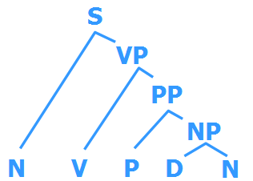
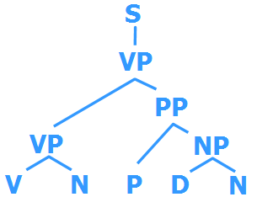
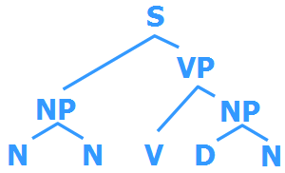
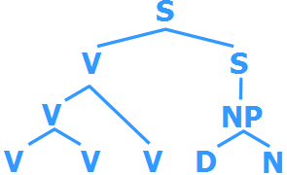
p(parse | sentence)
Time flies like an arrow
Time flies like an arrow
…
Time flies like an arrow
Time flies like an arrow
600.465 - Intro to NLP - J. Eisner
50

Slide 51
p(RHS | LHS)
S →
NP VP
S →
N VP
S →
NP[+wh] V S/V/NP
…
S →
VP NP
S →
Det N
S →
PP P
600.465 - Intro to NLP - J. Eisner
51

Slide 52
p(RHS | LHS)
S →
NP VP
S →
N VP
S →
NP[+wh] V S/V/NP
…
S →
VP NP
S →
Det N
S →
PP P
NP →
NP VP
NP →
N VP
NP →
NP CP/NP
…
NP →
VP NP
NP →
Det N
NP →
NP PP
…
600.465 - Intro to NLP - J. Eisner
52

Slide 53
p(tag sequence | word sequence)
Time flies like an arrow
Time flies like an arrow
…
Time flies like an arrow
Time flies like an arrow
600.465 - Intro to NLP - J. Eisner
53

Slide 54
Other topics we could discuss, time permitting
Survey of NLP tasks
Feature engineering
Dynamic programming algorithms: (hyper)paths in (hyper)graphs
Semantic representations
Neural methods, seq2seq, LLMs, neural structured prediction

